Slide 1

Data-Science Capstone

Slide 2
Introduction
The Coronavirus is an infectious disease that has infected well over 3 million people worldwide. The virus that causes COVID-19 is mainly transmitted through droplets generated when an infected person coughs, sneezes, or speaks. These droplets are too heavy to hang in the air. They quickly fall on floors or surfaces. You can be infected by breathing in the virus if you are within 1 metre of a person who has COVID-19, or by touching a contaminated surface and then touching your eyes, nose or mouth before washing your hands.
The most effective way to prevent the spread of the virus is through social distancing and preventing large gatherings in any specific areas. Many countries and cities have implemented a quarantine initiative to stop the spread of the virus, however many people are losing their jobs and business are losing their income cause the economy to decline. Therefore, the quarantine period will end, and many will contract the virus.

Slide 3
Solution (Data):
When the quarantine end effective steps will need to be put in place to prevent the continued spread of the virus. Foursquare data will be used to identify the areas of city that a popular/trending and alert the user that the areas identified have a higher chance of spreading the virus and that users must avoid going to the specified areas. New York will be used as the test case for this solution as it is one of the cities with the highest mortality rates, mainly of African Americans.
.

Slide 4
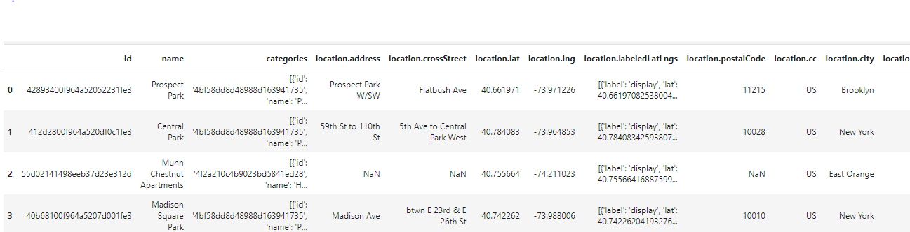
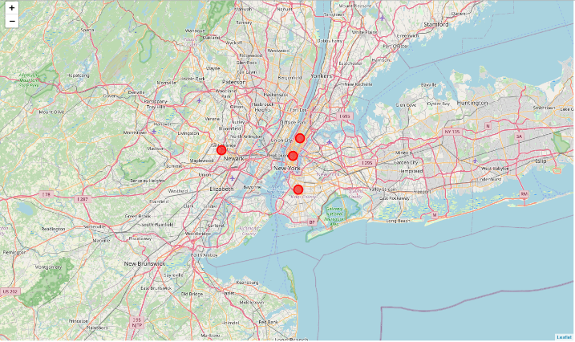
Methodology:
Using the foursquare API we were able to extract the most popular/trending areas in New York. The location data was then visualised to display to the user that these areas are likely to contain the virus. Therefore, they should be avoided if possible. The location data was parsed into a data frame.

Slide 5
Results:
The results were a list area that are likely to have a high rate of infection for the corona virus.
The following areas are a high risk of contracting the Corona Virus
Prospect Park
Central Park
Munn Chestnut Apartments
Madison Square Park
Note that the most popular areas are public pars and apartments. This is mainly do to the currently national lockdown. People use the parks to get in their regular exercise and walk their pets, otherwise they have to remain in doors. It is likely that new places will be added when the lockdown is lifted.
.

Slide 6
Discussion & Conclusion:
Using this system, the government can start tracking areas that need to control population to prevent the spread of the virus. It is likely that this kind of lifestyle will be the new normal for the next 1-2 years in order to ensure the eradication of the virus and to flatten the curve
Note that the most popular areas are public pars and apartments. This is mainly do to the currently national lockdown. People use the parks to get in their regular exercise and walk their pets, otherwise they have to remain in doors. It is likely that new places will be added when the lockdown is lifted.
.
Technology is a key player in the prevention and elimination of the coronavirus, in order to do this people will need to adhere to medical recommendations and use tools such as this to ensure that the least number of deaths occur. This project can be improved to provide a viable solution to assist in the prevention of the spread of the virus.

